Slide 1
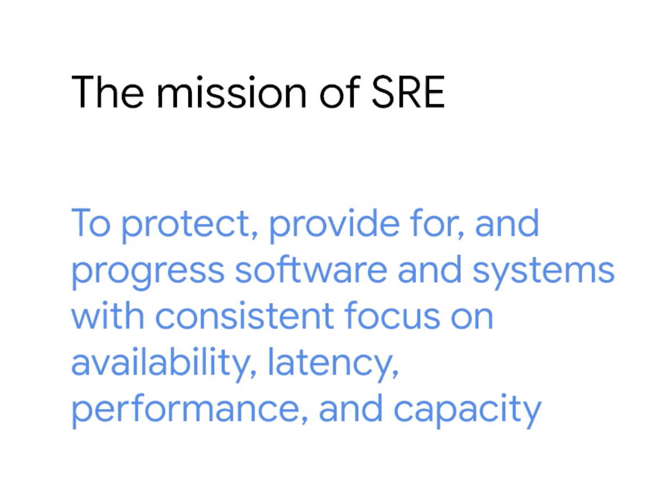
Notes:
Why SRE
1. It has worked !
2. They do lot more than B2O – CI/CD, SLIs & SLOs, Get in and code!
3. Behavioral based as well – they do it for good.

Slide 2
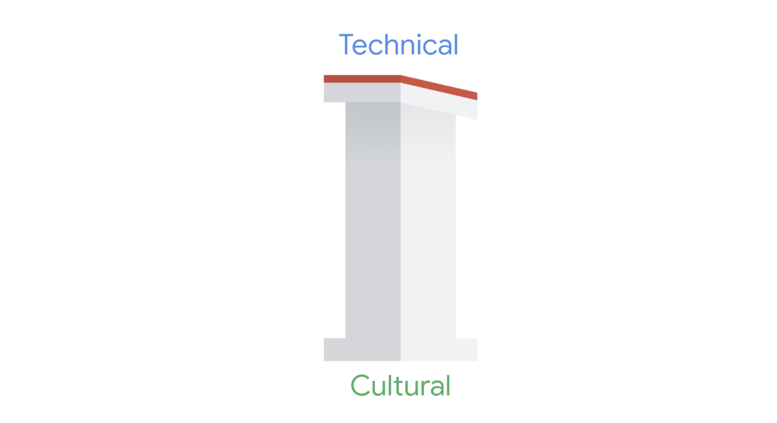

Slide 3
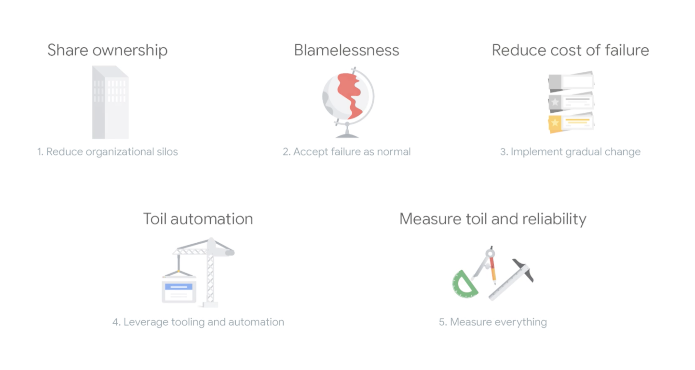
Notes:
3 -

Slide 4
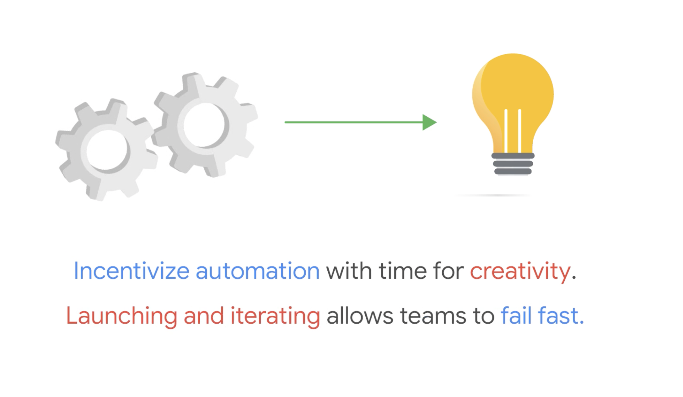

Slide 5
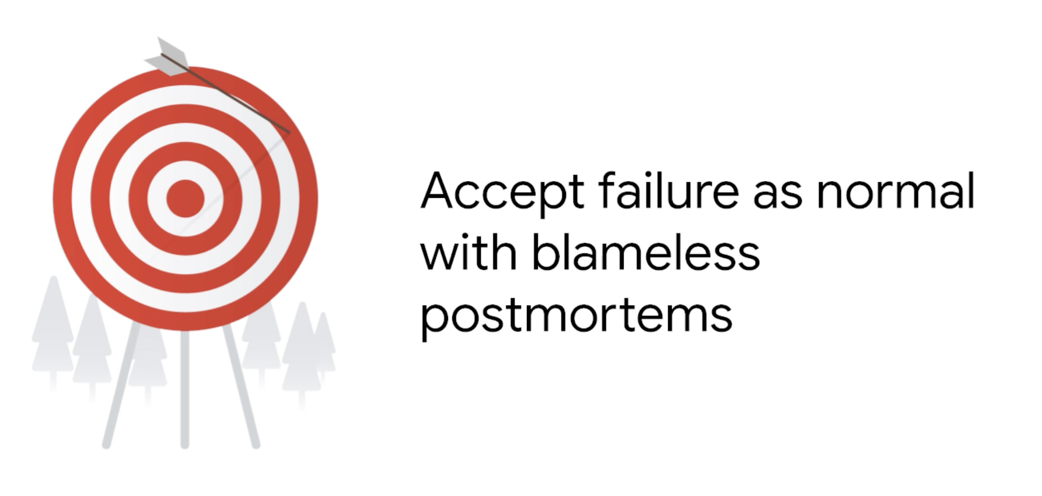

Slide 6
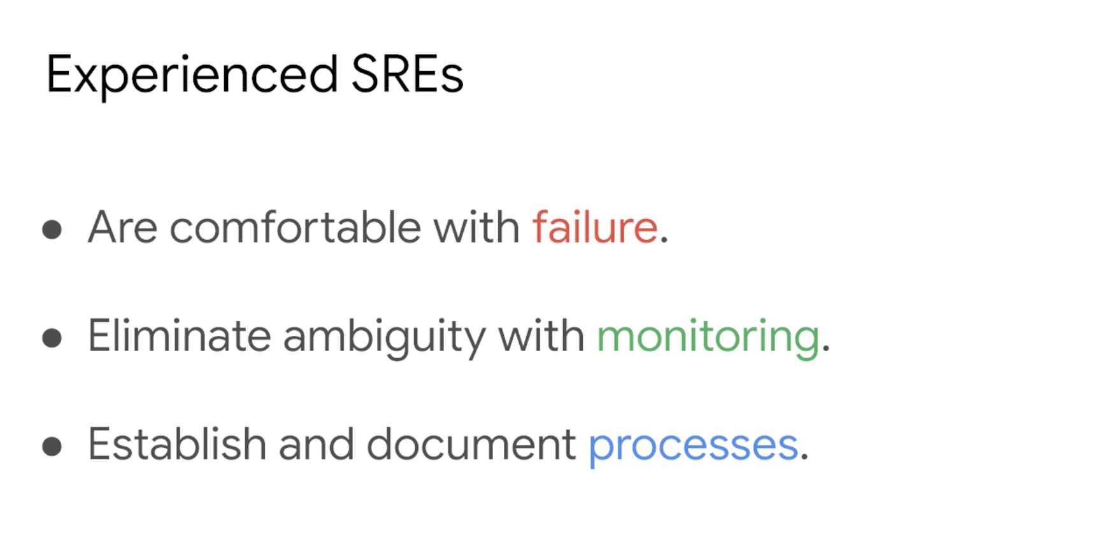

Slide 7
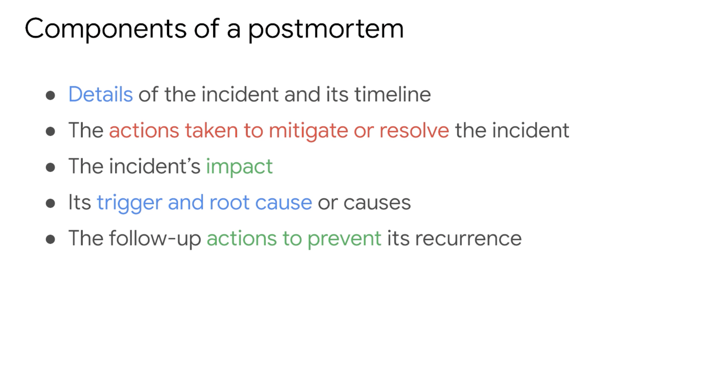

Slide 8


Slide 9


Slide 10

Notes:
Quick fixes are like bandaids

Slide 11

Notes:
Focusing on blamelessness helps to increase the effectiveness of your teams. They become 100% focused on preventing a problem from recurring instead of worrying about being blamed if something goes wrong. It also promotes a culture of psychological safety

Slide 12
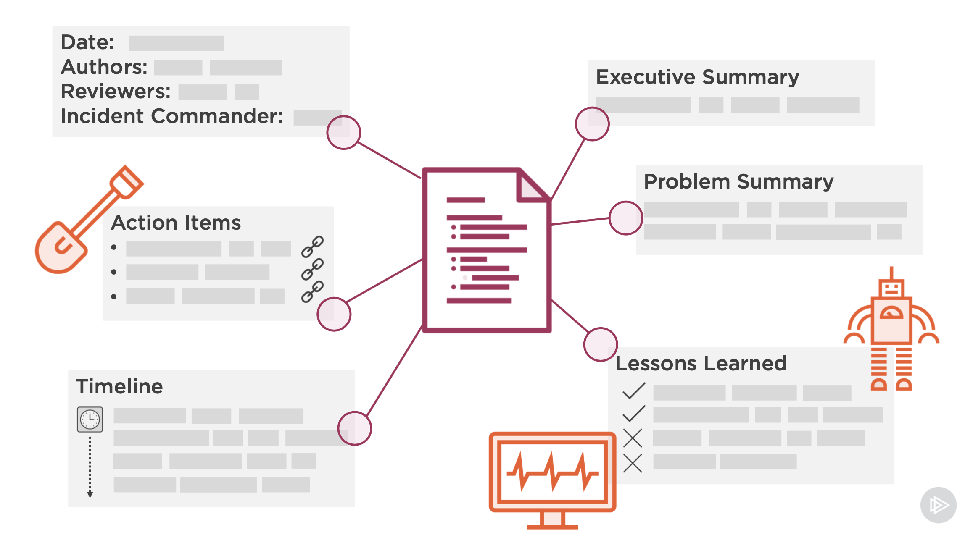

Slide 13
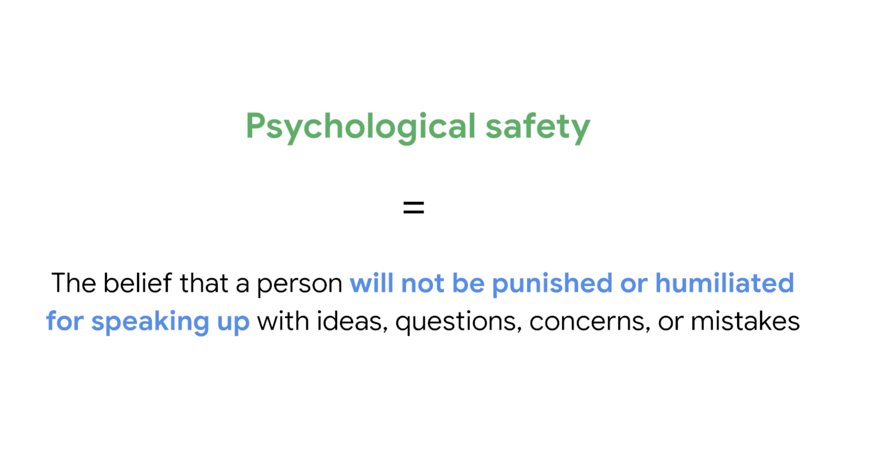

Slide 14
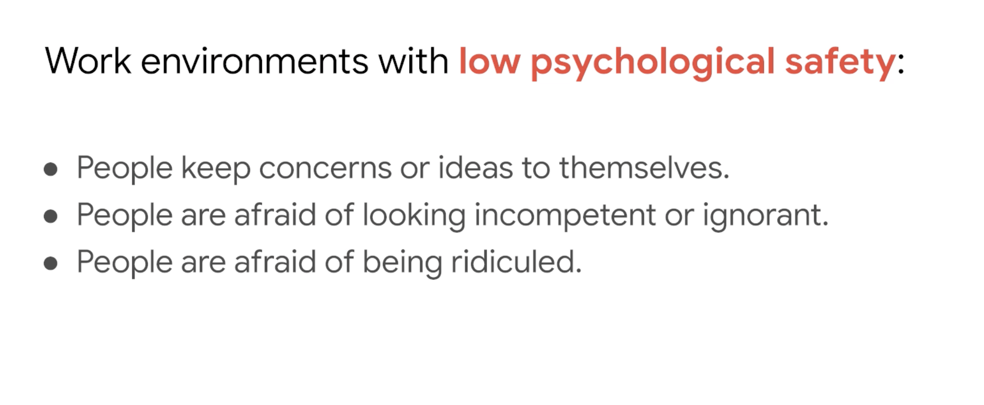

Slide 15
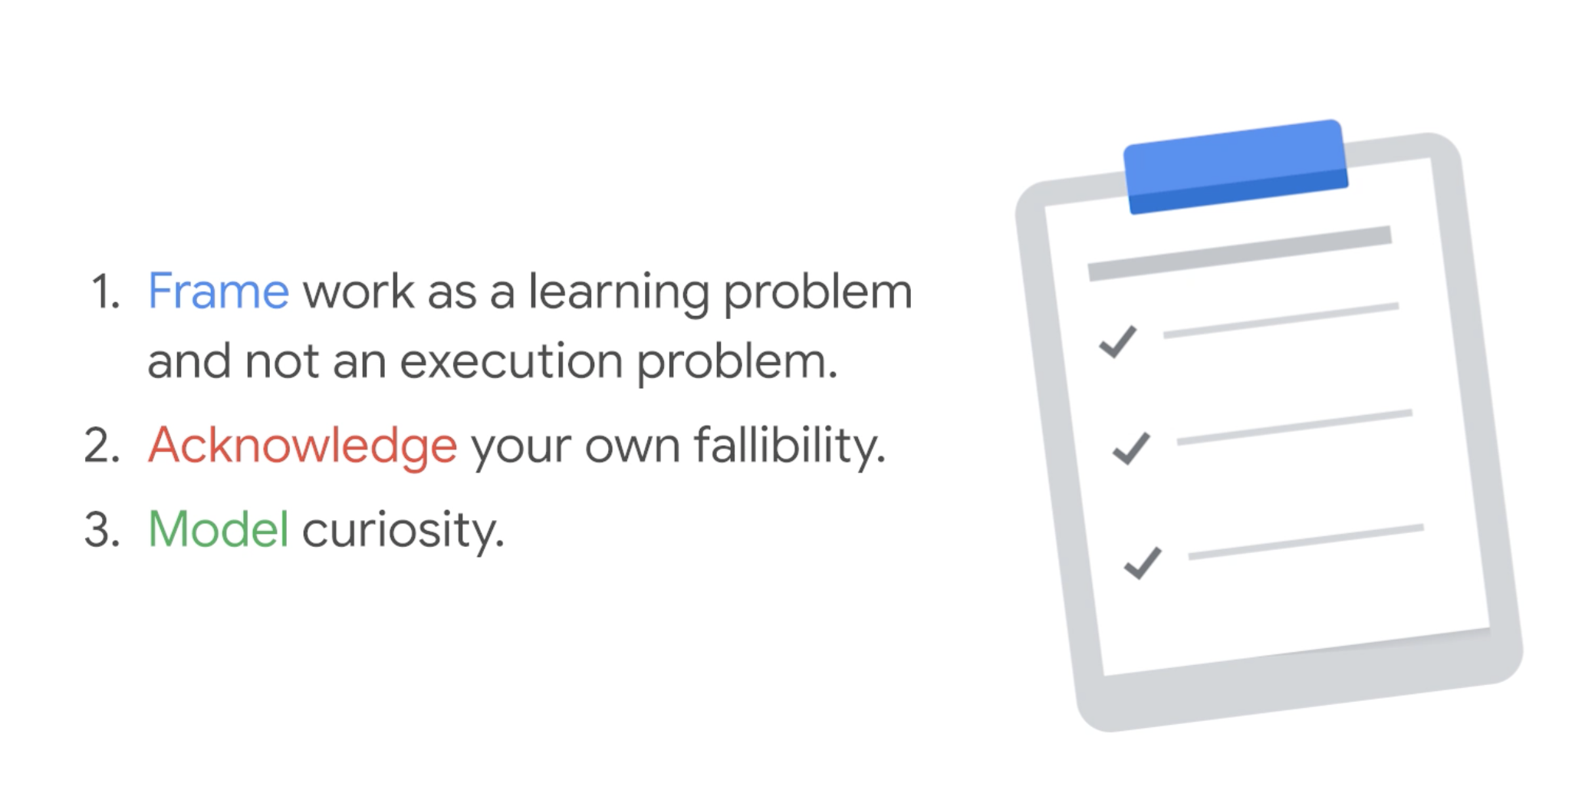
Notes:
Building Psychological Saftey

Slide 16
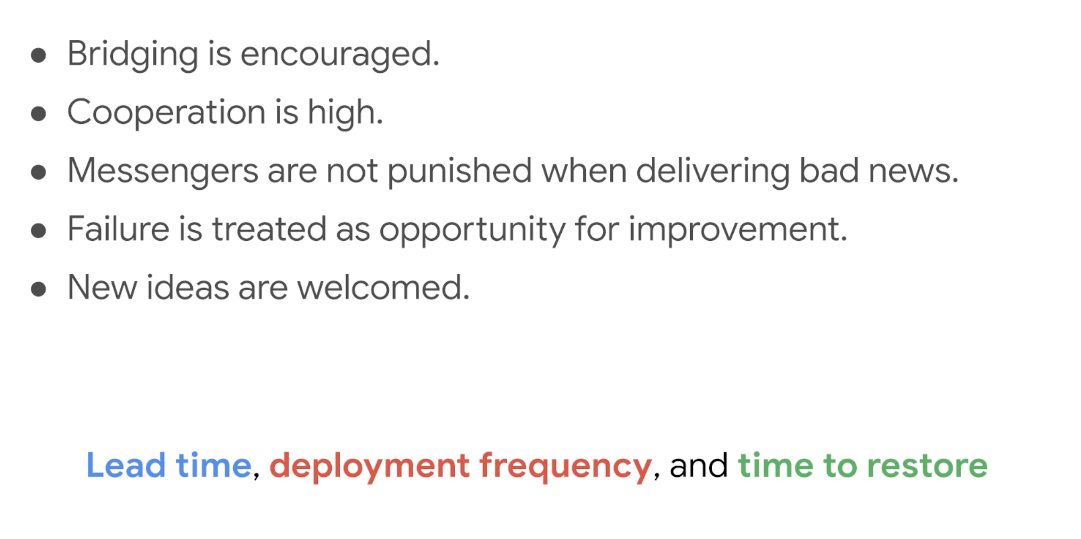
Notes:
Shifting team focus from blaming individuals to analyzing processes is a transformation in how engineering teams operate. It has long‑term benefits in fostering psychological safety and establishing trust.

Slide 17
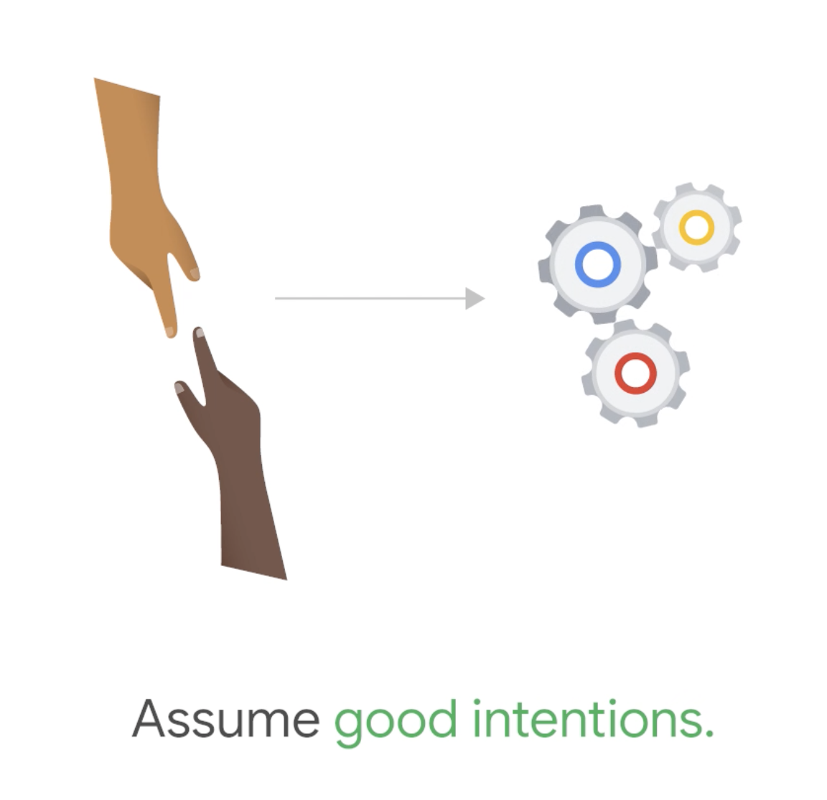
Notes:
Blamelessness is the notion of switching responsibility from people to systems and processes. In finger‑pointing organizations, where the first question of manager asks after an incident is who did this, employees become much more risk averse and fearful. It's best practice to assume that individuals act in good faith and make decisions based on the best information available. Investigating the source of misleading information is much more beneficial to the organization than assigning blame. In short, don't focus on people, focus on systems and processes to better support people making the right choices when designing and maintaining complex systems.

Slide 18
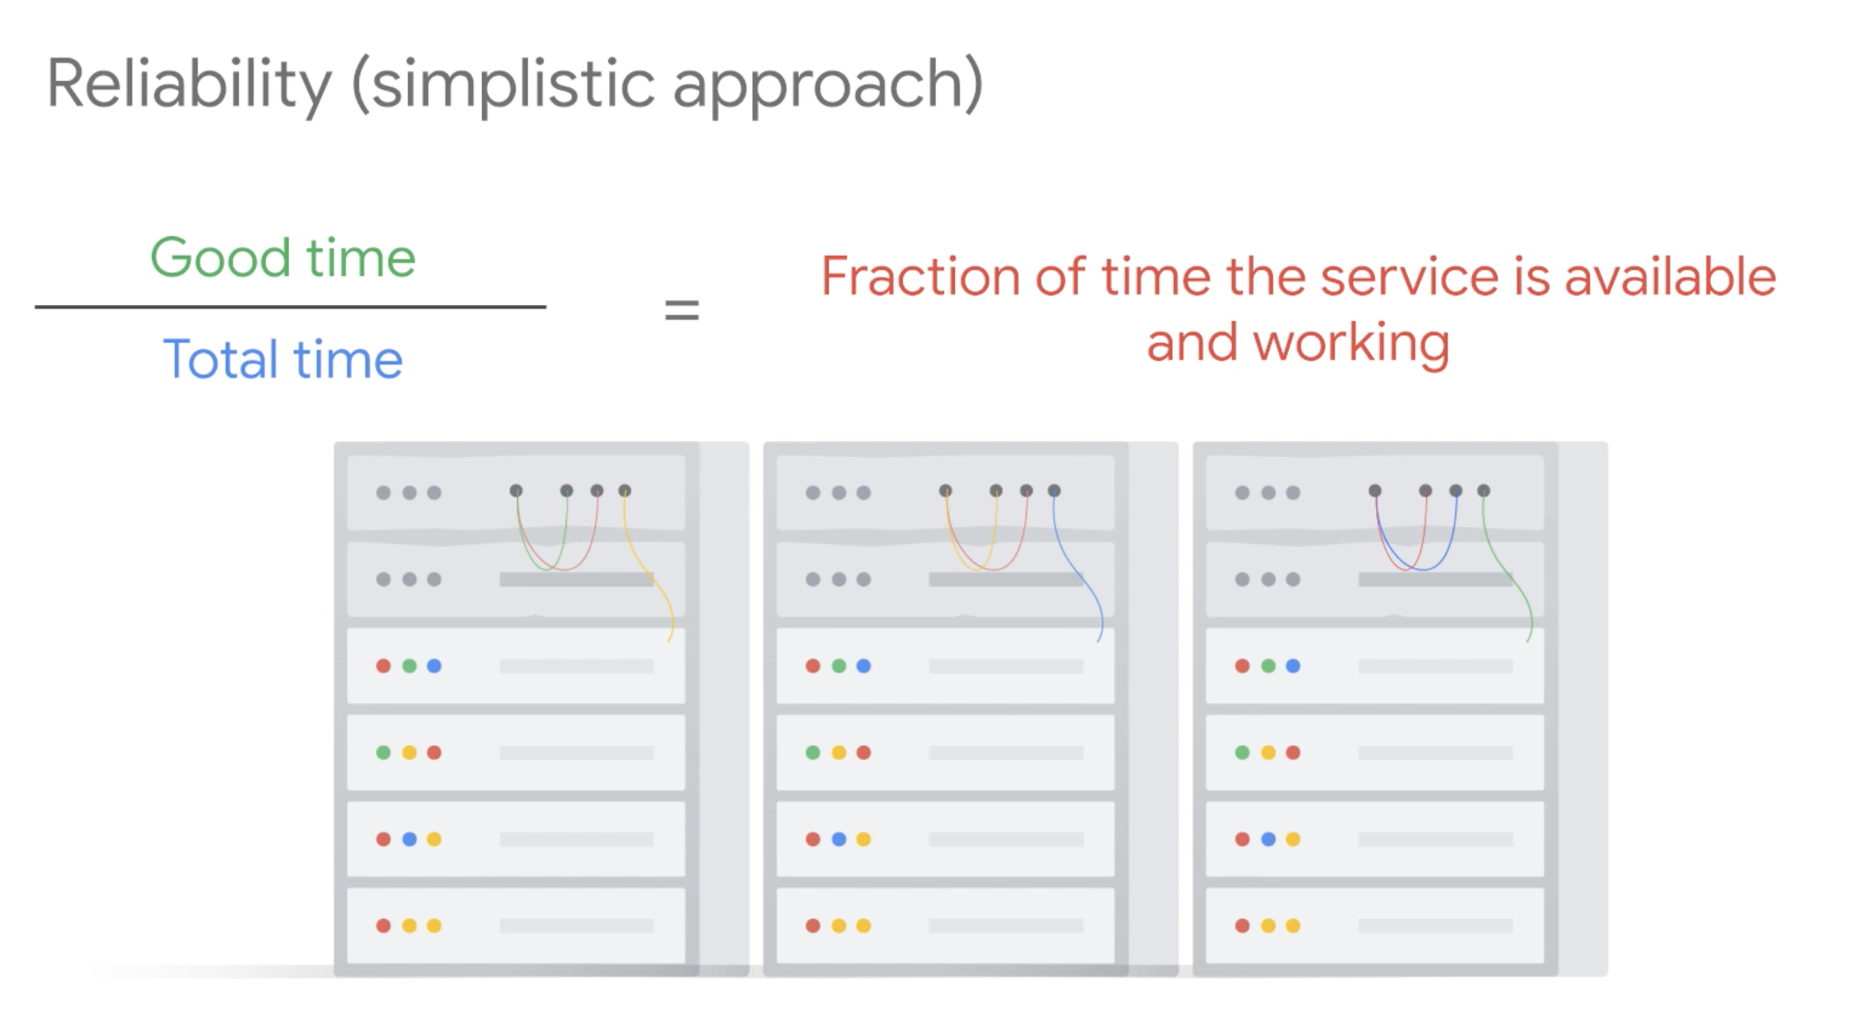

Slide 19
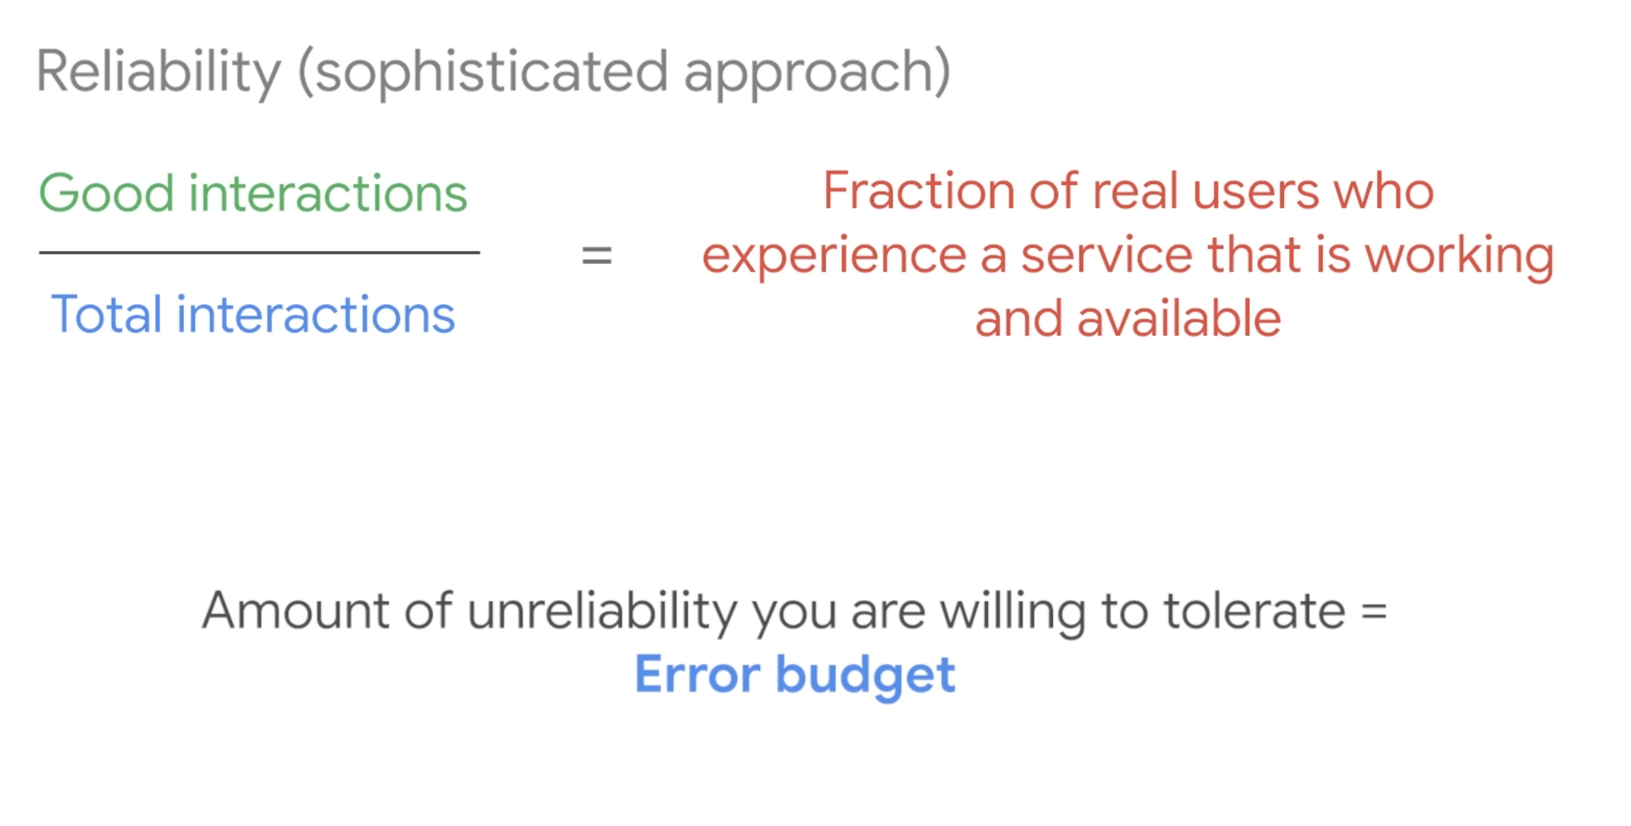

Slide 20


Slide 21


Slide 22
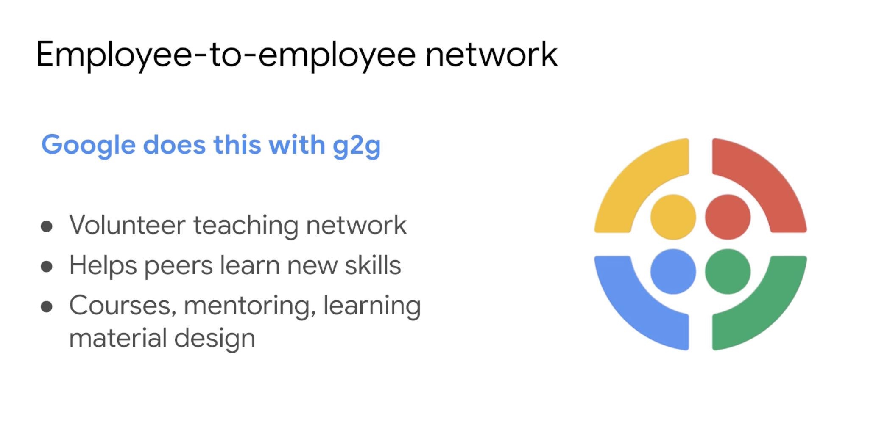

Slide 23
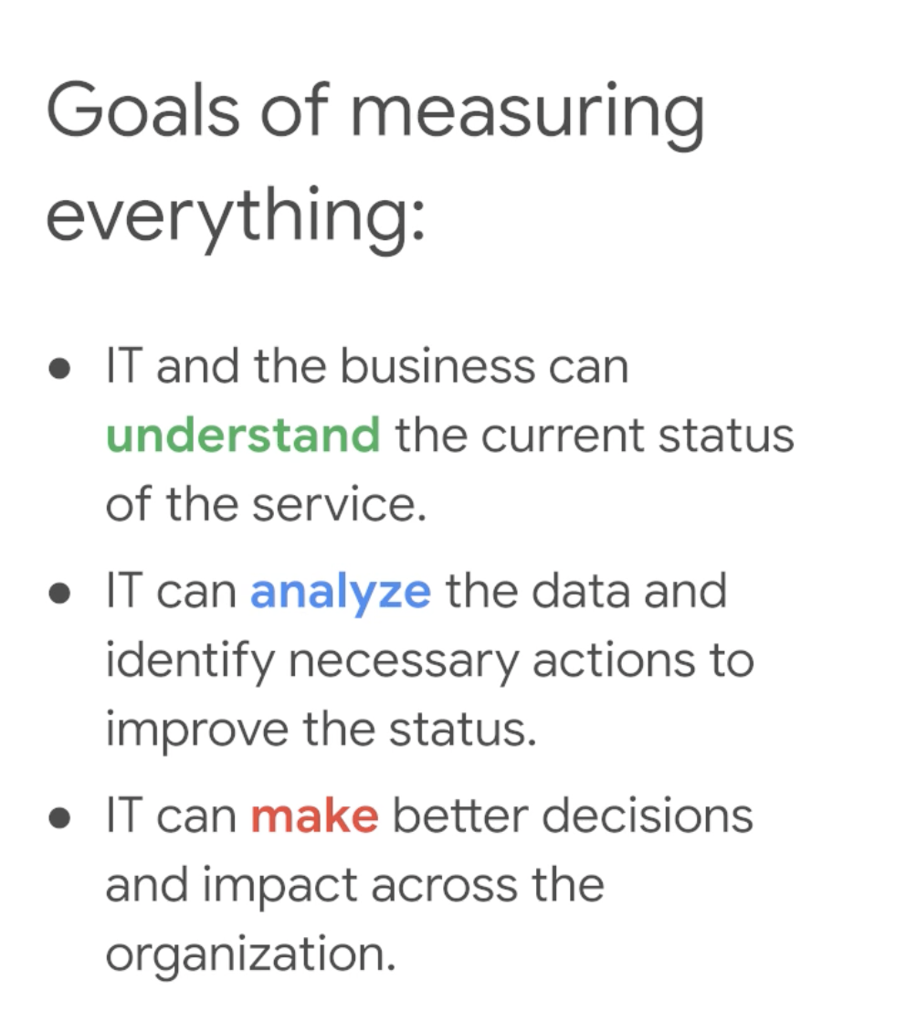
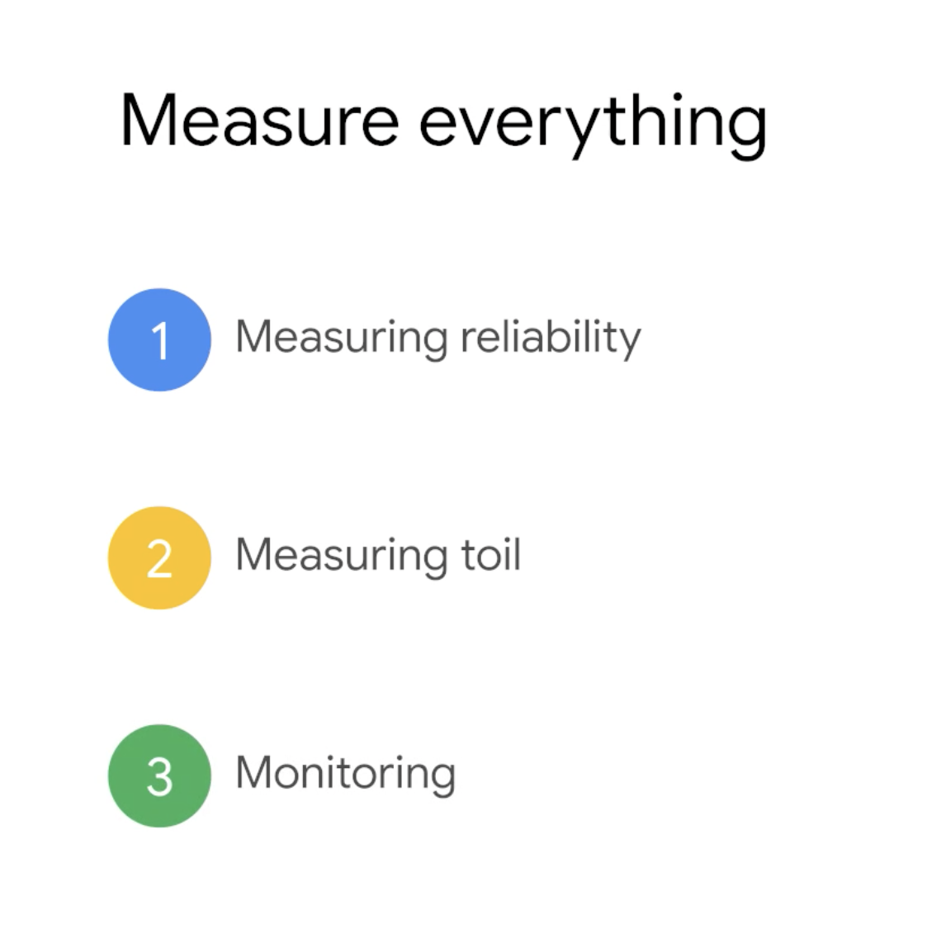
Notes:
You cant improve what you DO NOT measure

Slide 24
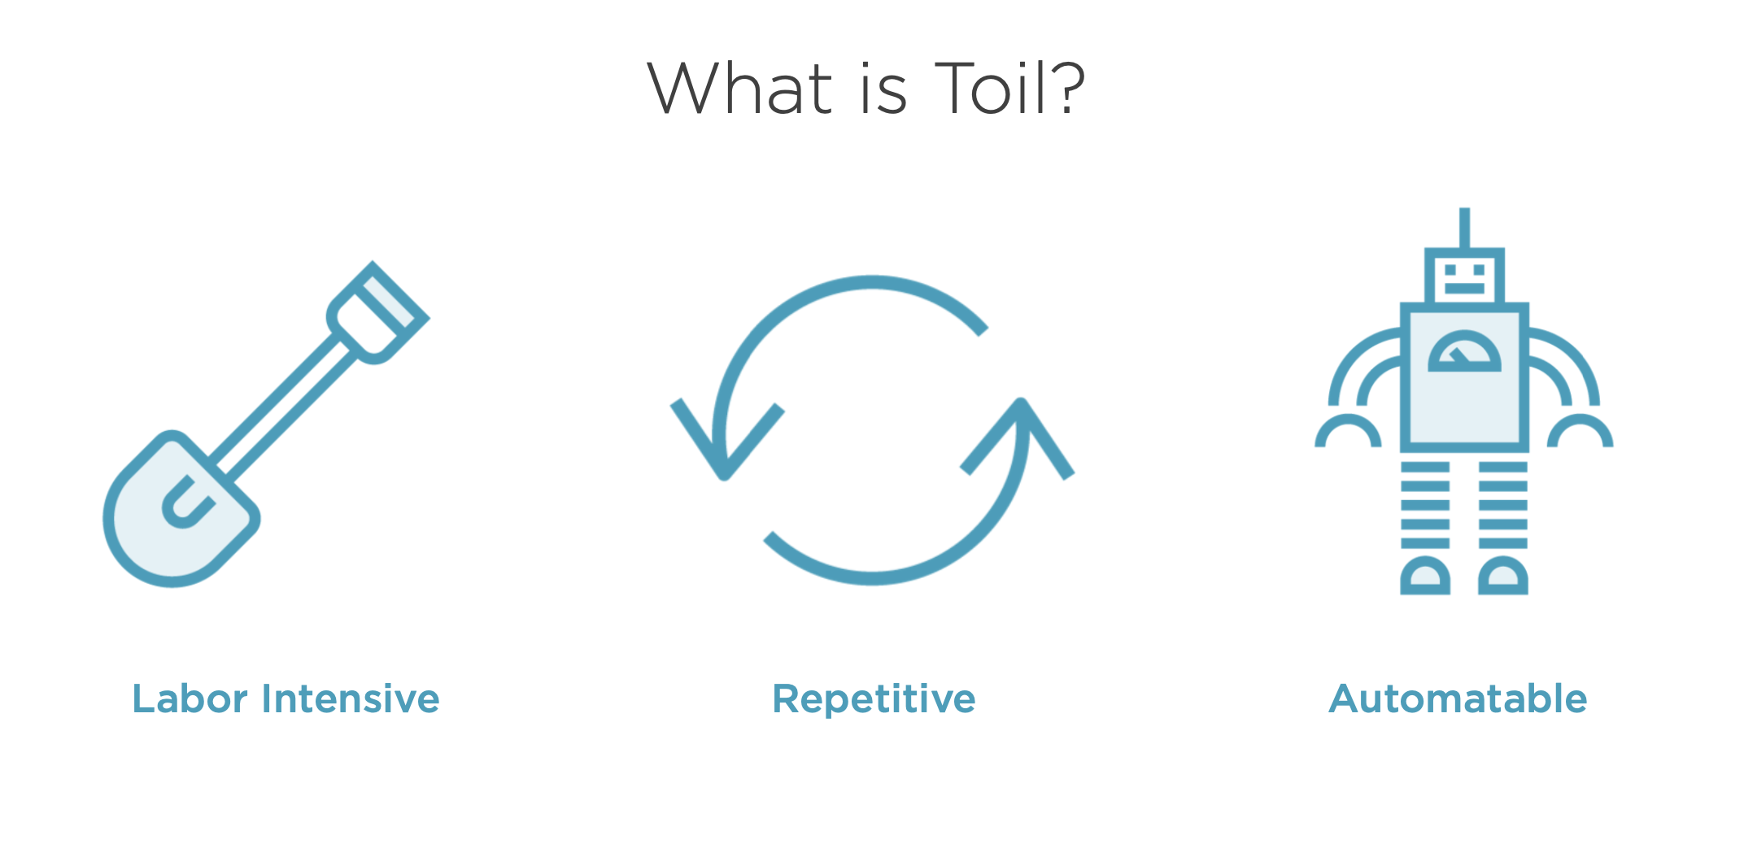

Slide 25
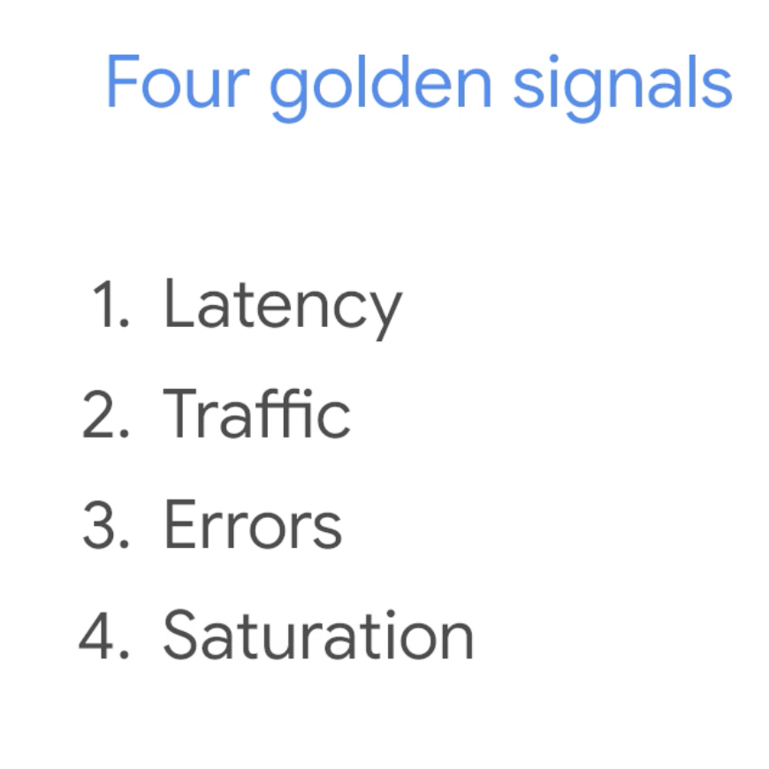
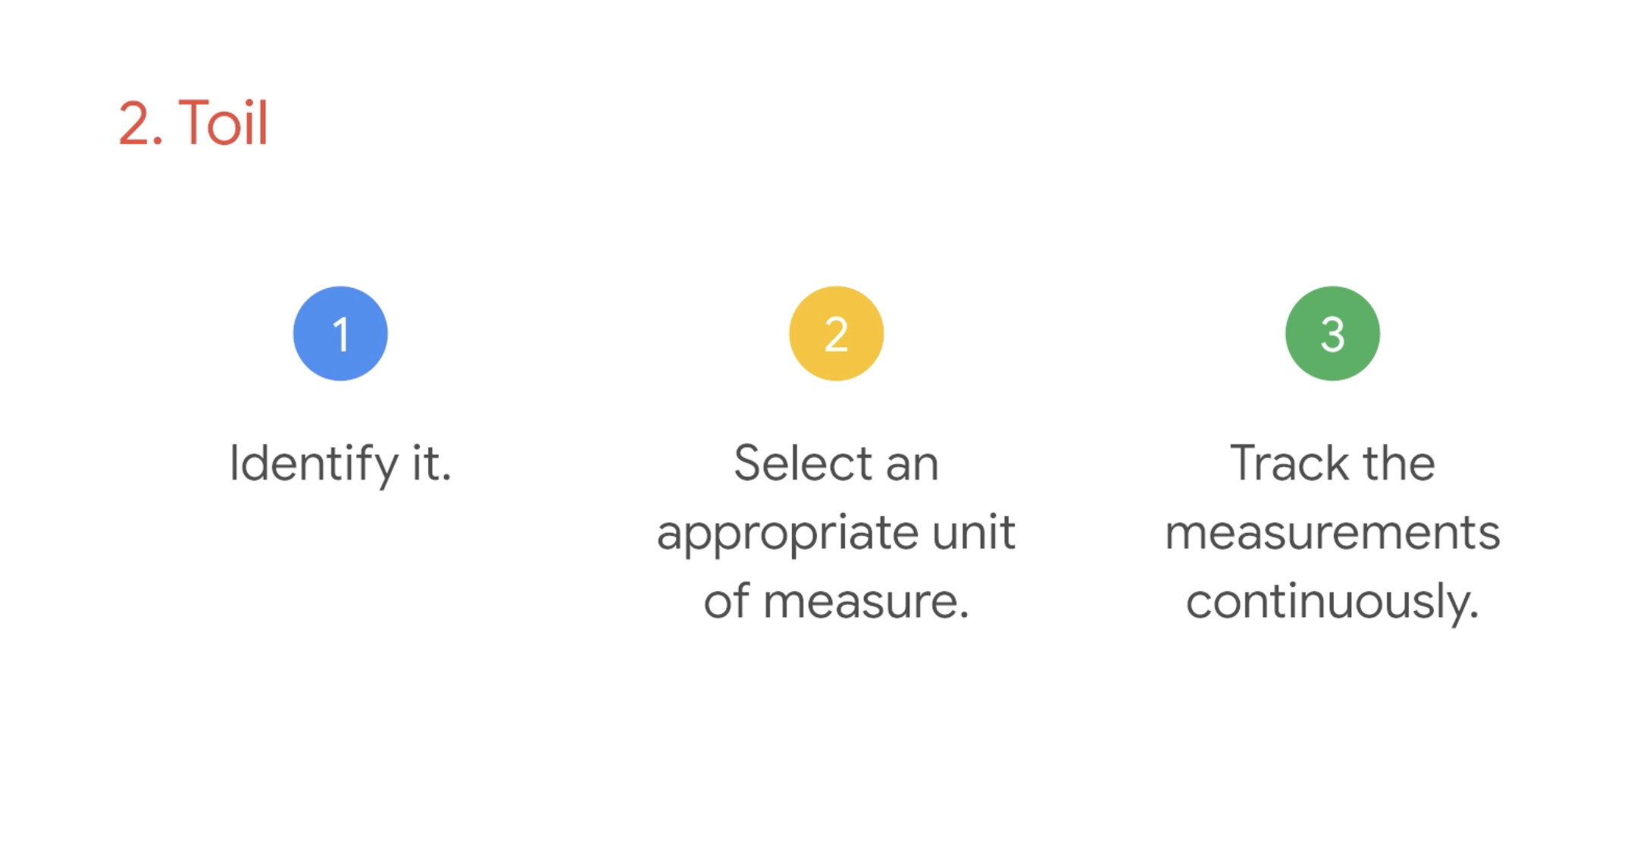
3. Monitoring

Slide 26
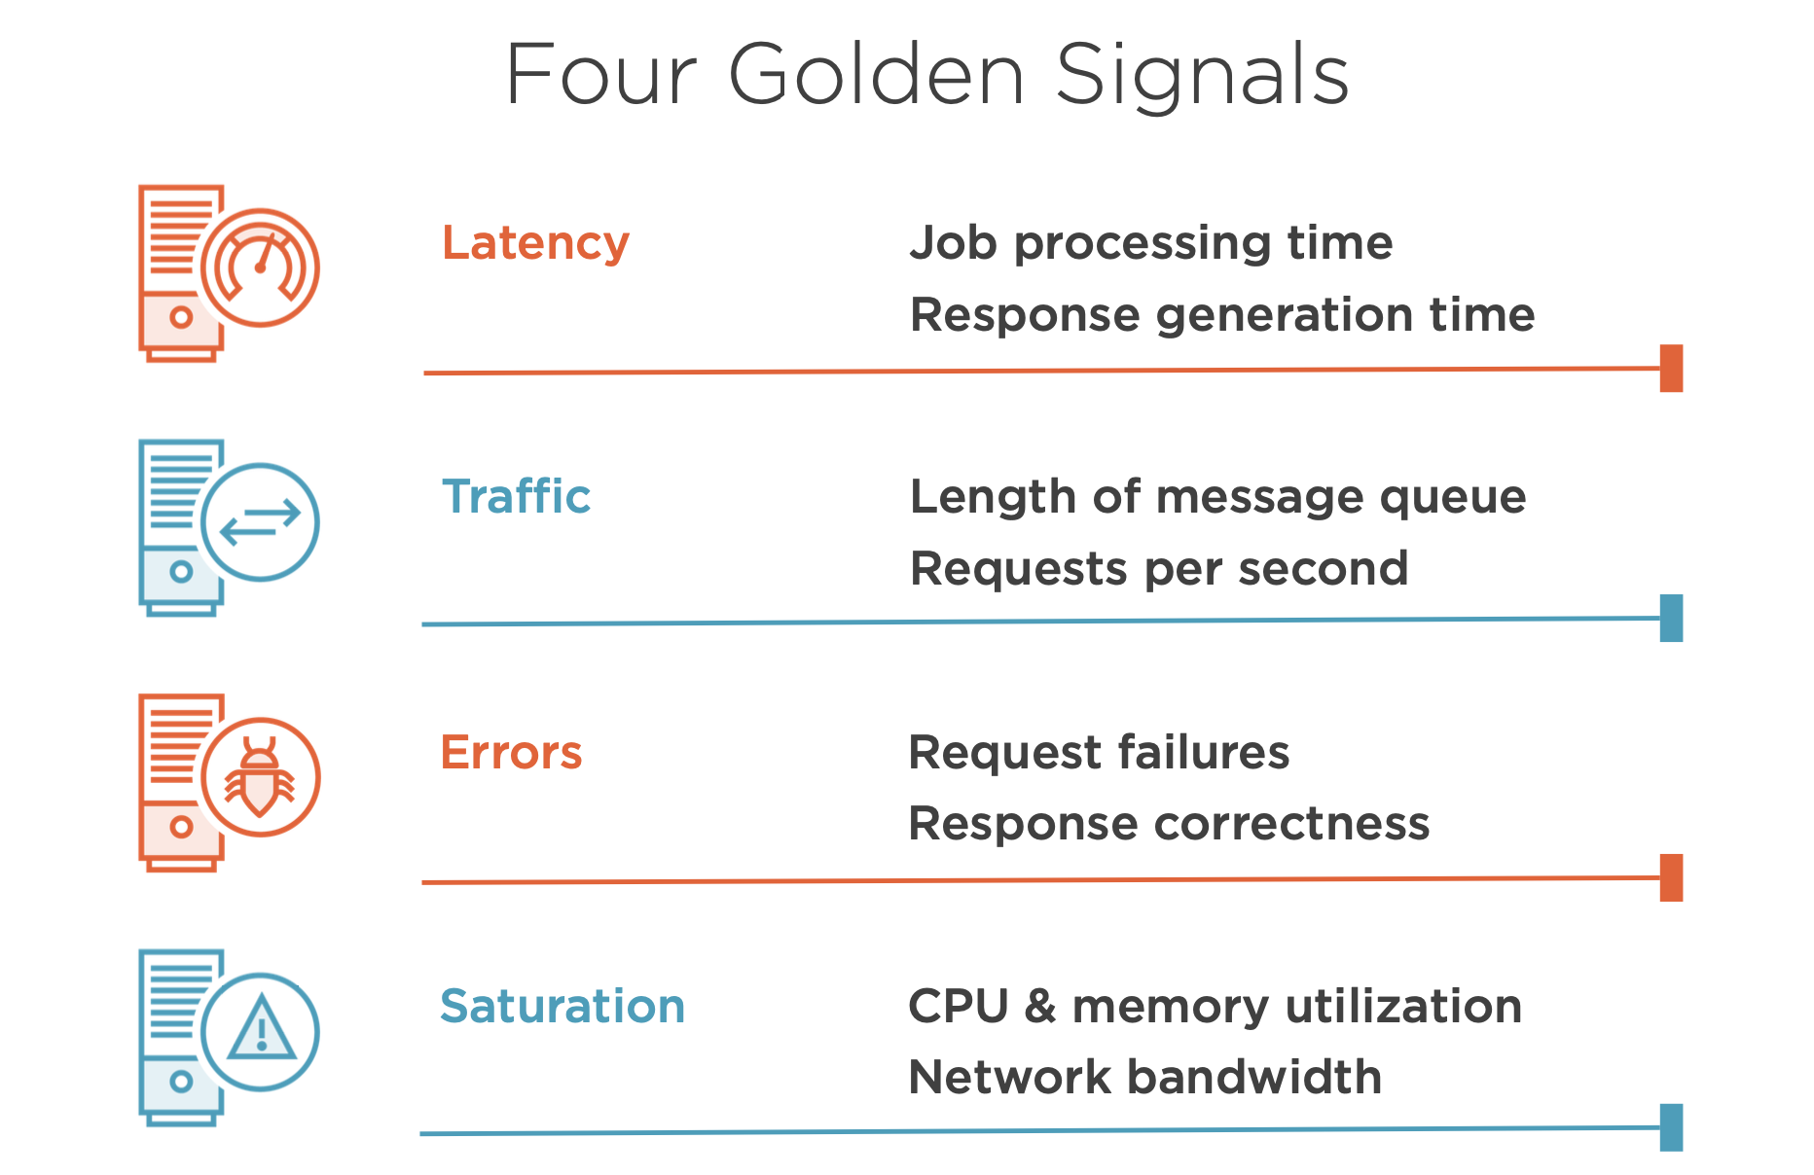

Slide 27
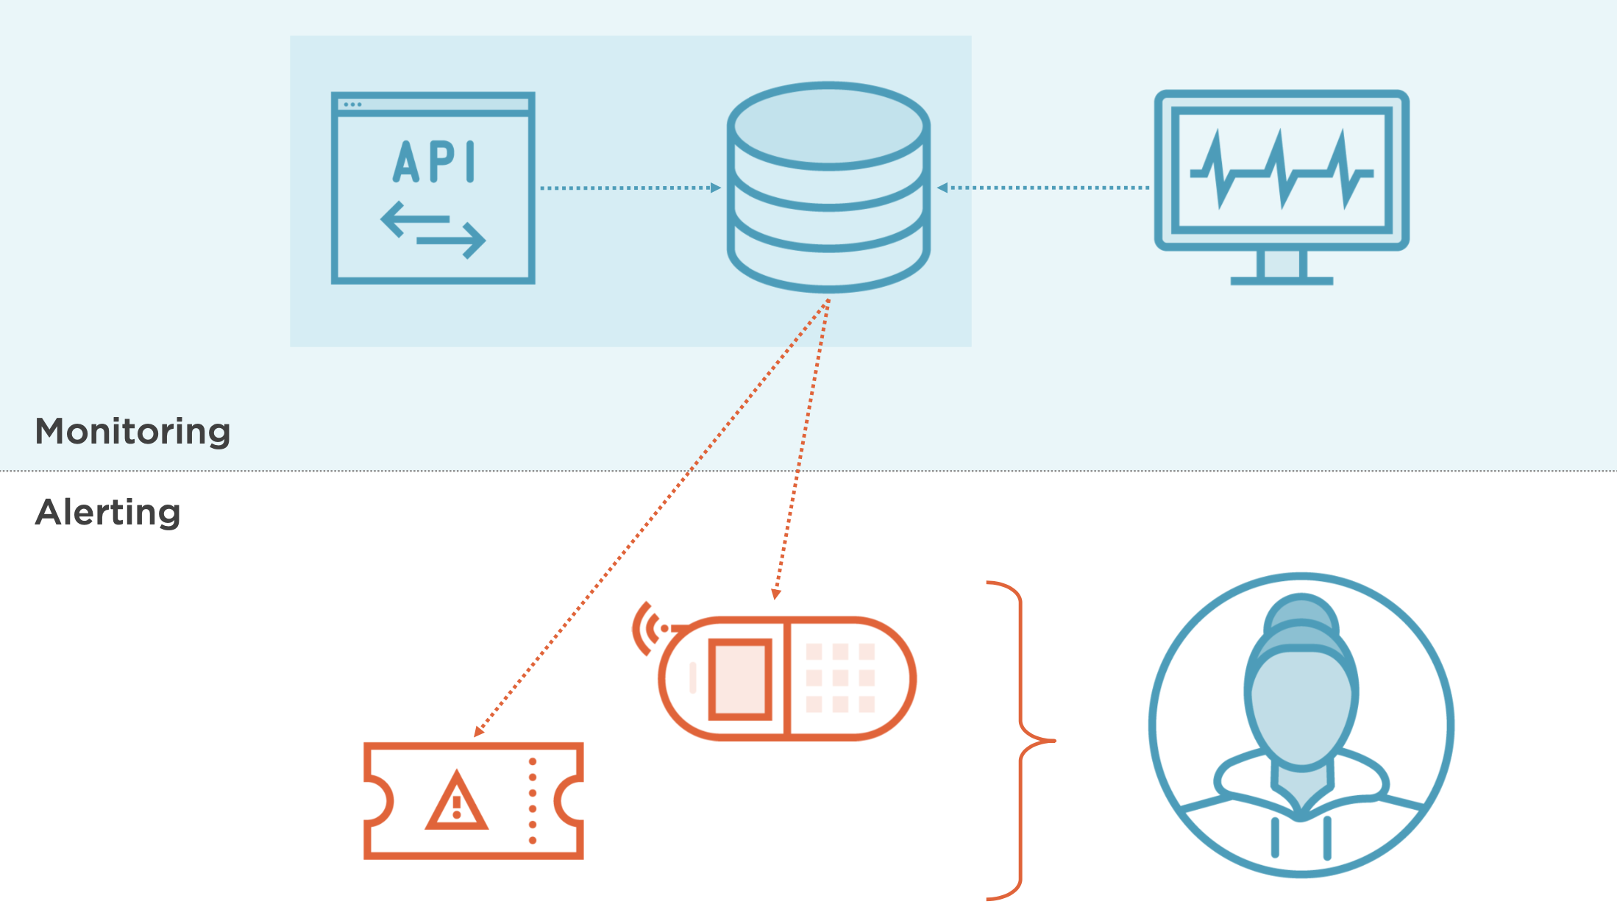

Slide 28
